Slide 1

Analysis of Hotel Booking Data
Shivesh Kumar Verma

Slide 2
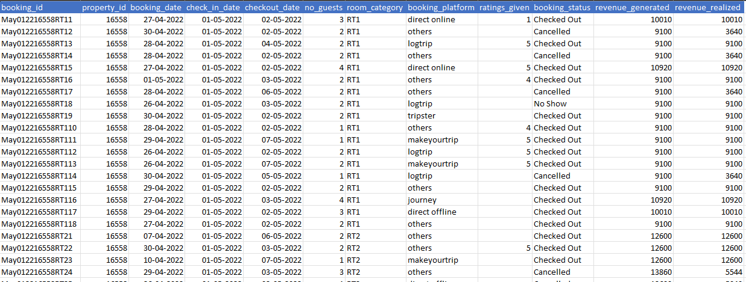
INTRODUCTION
The dataset contains booking information for a hotel, including booking IDs, property IDs, dates, guest counts, room categories, booking platforms, ratings, statuses, and revenue figures.
The data spans bookings made in April 2022.
.

Slide 3

PRIMARY GOALS
Quarterly Revenue Analysis

Slide 4
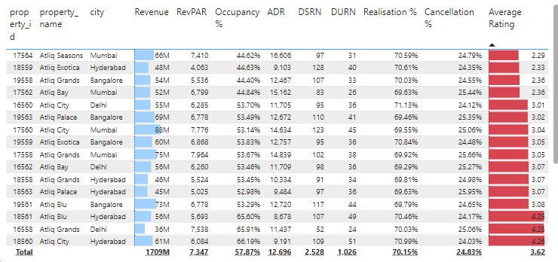
overall booking analysis

Slide 5
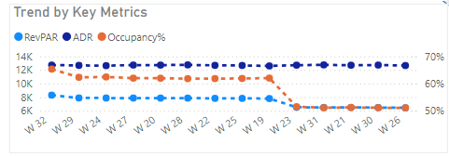
hotel's performance.
The metrics ADR, RevPAR, and Occupancy Rate collectively provide a comprehensive view of a hotel's performance.
Revenue Management: Higher ADR reflects effective pricing strategies, while increased RevPAR indicates overall revenue efficiency.
Operational Efficiency: A high occupancy rate signifies successful marketing efforts, showing the hotel's ability to attract guests.
Financial Health: Analyzing these metrics together helps identify trends, assess competitive positioning, and inform decisions on pricing and promotions.
RevPAR, or Revenue Per Available Room, the revenue generated per available room, regardless of whether the room is occupied
ADR, or Average Daily Rate, the average revenue earned for each occupied room per day.

Slide 6
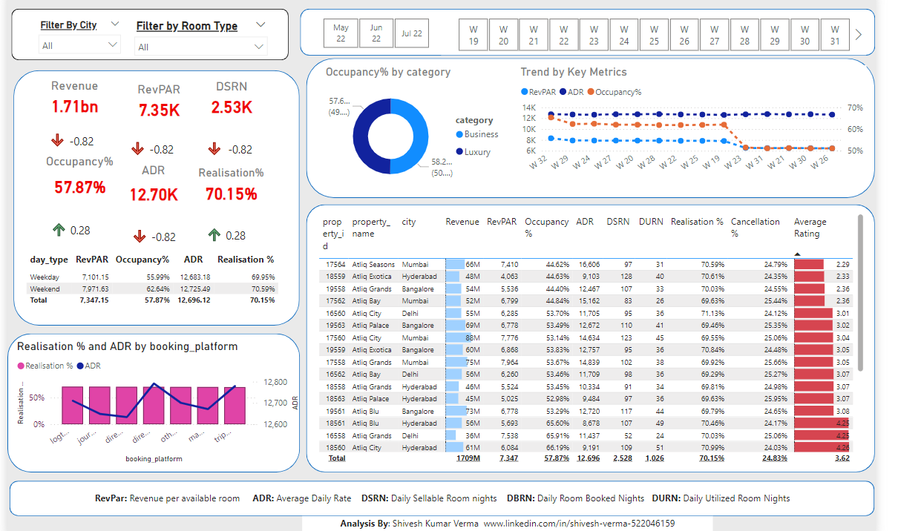

Detail analysis
President
Chief Executive Officer
Chief Operations Officer
VP Marketing

Slide 7

THANK
Shivesh Kumar Verma
www.linkedin.com/in/shivesh-verma-522046159
You

